Slide 1

Google Play Store App Success Prediction Tool
Applied Statistical Analysis with R Final Project Presentation

Slide 2

Agenda
Introduction
Objective
Analysis Expectations
Data Source
Analysis and Modelling
Data Preparation
ANOVA Test
Predictive Analytics
R Shiny
Conclusions & Further Scope

Slide 3

Introduction
In 2023, it is estimated that the annual number of app downloads worldwide will amount to 299 billion, up from approximately 247 billion global app downloads in 2020.
As of 2023, 3.5 billion apps are available for download on Google Play Store. This indicates a meteoric rise of mobile application usage in the recent past and how they will continue to play a major role in the lives of digital consumers and businesses – small, medium, or large.
Apps have been increasingly improved to meet every form of consumer demand. From banking, delivery, and cab-hailing apps to the ever-popular gaming, dating, and social media apps, mobile applications are used by every individual with a mobile device.
Thus, launching a mobile app is a popular strategy for companies and other entities when it comes to creating a digital footprint or expanding an already existing one.

Slide 4

Objective
The solution is intended to aid the user in designing data-driven strategies to either explore a niche category or implement market entry/ business expansion through their app development, gauging trends, and insights into existing apps.
Users of our solution can include Product Manager, App Developers, Marketing Analysts
The solution would also help the user visualize the impact of variations of key variables on the overall success estimate of the app.

Slide 5
Analysis Expectations
Exploratory Data Analysis
Inferential Analysis
Predictive Analysis

Slide 6

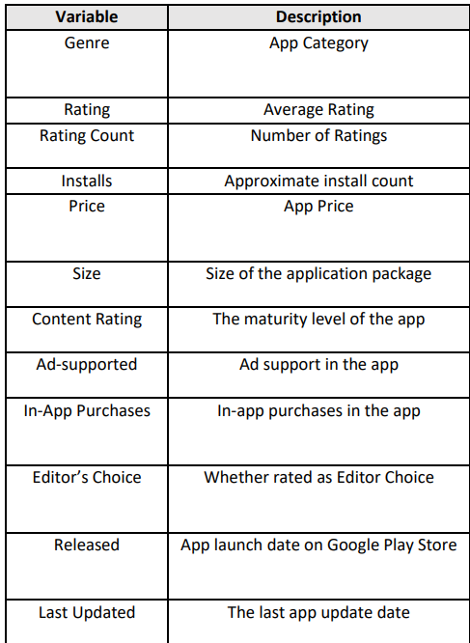
Data Source
Key Variables in the Dataset
Google Play store Dataset was obtained through web scraping from the Google Play Store in June 2021 and contains application data for more than 600K apps from various categories
The Play store Dataset has ~2.3Mn rows of data with 24 columns, the key columns utilized in our analysis are shown in Fig on right.

Slide 7

Analysis & Modelling
How do we measure App success?
Conventionally, we judge an app by parameters such as – Rating, Count and Type of Reviews as well as No. of Installs.
In our analysis, we have combined the interaction of the above three parameters int one single scoring mechanism.

Slide 8
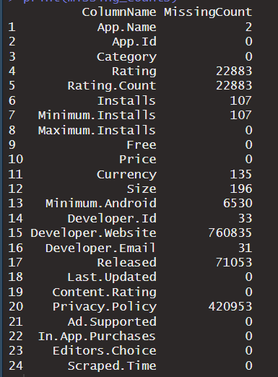
Data Preparation
Data Sanity Checks: Performed Missing Value Checks, Missing records of Rating 22,883 were removed from data
Performed duplicate checks on the data
~50k rows in the dataset were missing App Released Date This was handled using Min Android Version Release date
Fig: Missing Data Summary

Slide 9
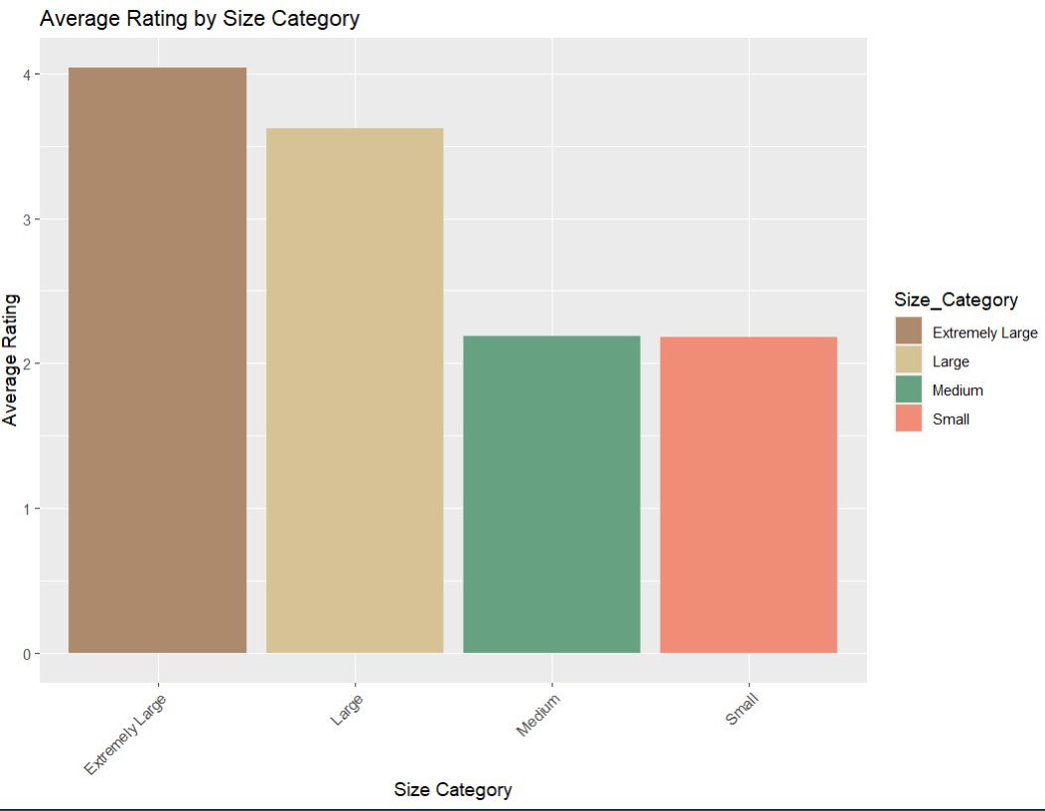
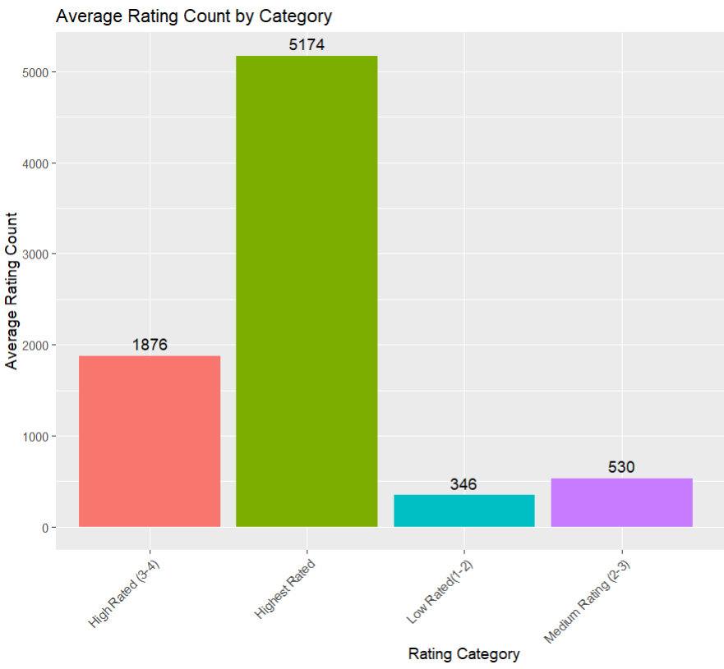
Data Exploration: Insights

Slide 10
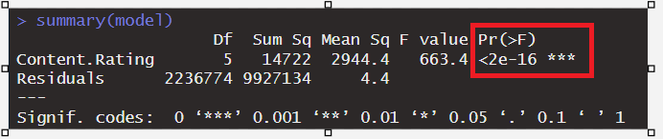
ANOVA Test To analyze whether the App Rating means is same across Content Rating Groups
6 Unique Categories of Content Rating (Teen, Adult etc.)
H0: The Mean of App Rating is same across all Content Rating Groups
H1: At least one Content Rating group has a different mean
Since the p value of the AOV test is <0.05, we reject H0 and have sufficient evidence to support the statement that at least one population mean is different. To find means that are significantly different from each other, we use the single-step multiple comparison Tukey's HSD Test.

Slide 11
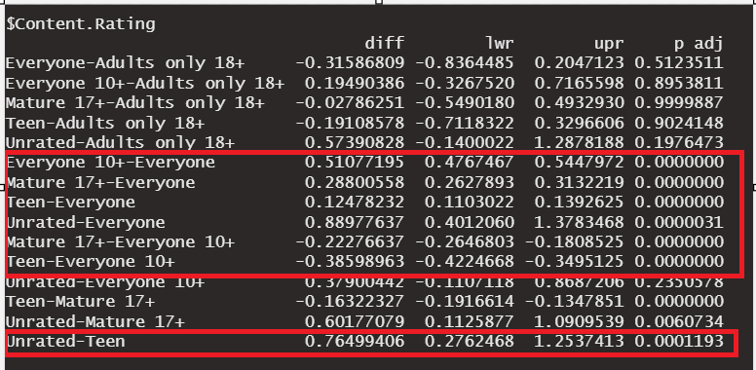
ANOVA Test
Tukey Honestly Significant Difference Test Results
From the results, we note that the among the content rating groups the difference in means is statistically significant for Unrated-Teen and Teen-Everyone 10+ groups

Slide 12
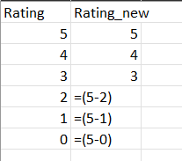

Feature Engineering
For “Category” variable, we have 46 levels which leads to creation of 45 dummy variables. Hence the large number of x-variables. :’(
One of the most important applications of variable creation was in the curation of the target variable from three x variables. The score devised in the above step is transformed using a sigmoid function and is converted to 0 and 1 by setting the threshold as 0.5
Dummy variables were created were all the categorical variables included in the model. This is why there are also there are a large no. of x-variables in the model.

Slide 13
Pre-Modelling Checklist
Check for Multicollinearity was done using a correlation matrix that showed that there existed multicollinearity between two variables
One of them was dropped from the modelling process.
The data was split into train and test data in 80:20 ratio.
Sampling done through selective sampling as cleaned dataset has over 2 million rows and it is a challenge for both R and R Shiny to take on the computational load.

Slide 14
Modelling Techniques Used
Logistic Regression
Random Forest
Decision Tree

Slide 15
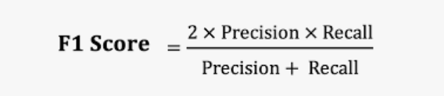
F1 Score: It’s result time!
F1 score is a classification metric that measures the model’s assign to predict true positives and true negatives. It is a better measure than accuracy when the data is imbalanced, as in our case.
F1 score uses both precision and recall. Higher the F1 score, better the model.

Slide 16
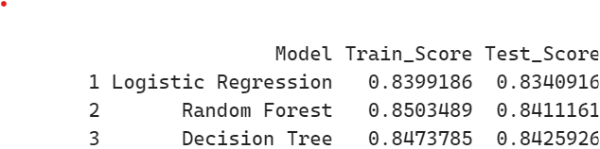
Model Selection
All three models generate a decent F1 train and test score.
All three models have low bias and low variance in train and test data.
Random Forest is the model that has the highest variance among the three, even though it is the one with the highest train score.
We select Logistic Regression as our model of choice owing to comparable F1 scores, low variance as well as high interpretability.

Slide 17
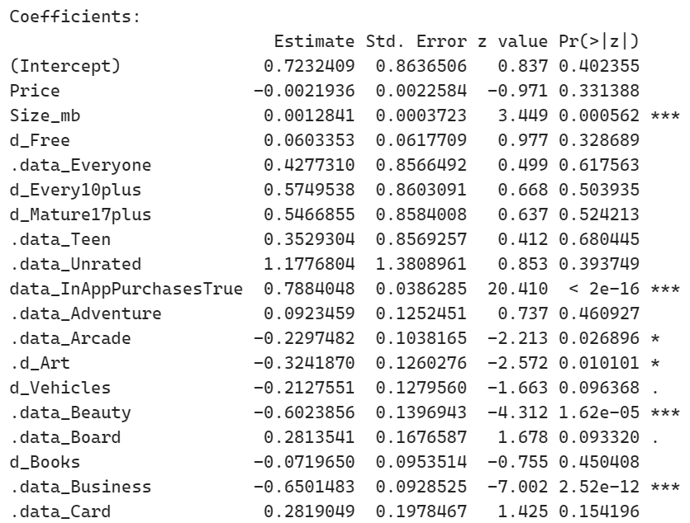
Inference on Classification Coefficients
Logistic Regression model generated multiple statistically significant variables at varying levels of significance.
However, we have not used the statistical significance of variables to include only such variables in our analysis.
Instead, the significance is a measure of how important these variables are in determining app success.
The coefficients of variables generate some important insights.
Quantitatively, it tells us by how much the log-odds ratio of app success changes with the variable.
Qualitatively, it tells us the nature of the relationship.

Slide 18
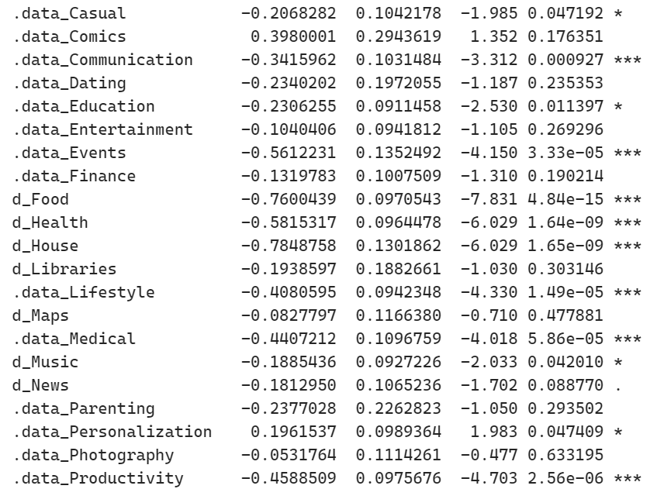
Nope. Not done with Coefficients yet.
Seemingly important categories such as Communication and Food are statistically significant at a very low level of significance(as expected)
However, the nature of relationship between app success and categories such as Communication and Food is negative, which is not expected
However, such a relationship could arise due to saturation in the respective category
Thus, our model also talks categories which might be obvious domains to build an app on, might not be a good idea due to presence of too many players in the market.

Slide 19

R Shiny Demo

Slide 20
Future Scope
Hyperparameter Tuning is a technique that can improve the model by heaps and pump up the predictive capabilities of the model.
Unable to use the full extent of data due to computational limitations. Would get better estimates if we were able to use all data instead of take a sample
Algorithms such as XGBoost, Support Vector Machines as well as Machine Learning techniques such as Neural Networks would give more robust output
In our analysis, owing to limitations of data, several variables that could improve the robust-ness of the model could not implemented.

Slide 21
Conclusion
The Google Play App Success Prediction Tool aims to give the user an indicative idea of the parameters that might maximise chances of app success given the current market.
The predictions made by the tool should be well supplemented by practical domain knowledge as well as business requirements and strategies.

